Slide 1
ECE408 / CS483/CSE408 Applied Parallel Programming Lecture 26: Introduction to OpenACC

Slide 2
Objective
To understand the OpenACC, a high-level programming model for CPU/GPU
basic concepts and pragma types
Simple examples to illustrate basic concepts and functionalities
A valuable tool to quickly adopt GPU code in large, existing C/C++/FORTRAN applications

Slide 3
OpenACC
The OpenACC Application Programming Interface (API) provides a set of
compiler directives (pragmas)
library routines and
environment variables
that can be used to write data parallel FORTRAN, C and C++ programs that run on accelerator devices including GPUs and CPUs

Slide 4
OpenACC Pragmas
In C and C++, the #pragma directive is the means to provide, to the compiler, information that is not specified in the standard language.

Slide 5
The OpenACC Abstract Machine Model

Slide 6
Simple Matrix-Matrix Multiplication in OpenACC
1 void computeAcc(float *P, const float *M, const float *N, int Mh, int Mw, int Nw)
2 {
3
4 #pragma acc parallel loop copyin(M[0:Mh*Mw]) copyin(N[0:Nw*Mw]) copyout(P[0:Mh*Nw])
5 for (int i=0; i<Mh; i++) {
6 #pragma acc loop
7 for (int j=0; j<Nw; j++) {
8 float sum = 0;
9 for (int k=0; k<Mw; k++) {
10 float a = M[i*Mw+k];
11 float b = N[k*Nw+j];
12 sum += a*b;
13 }
14 P[i*Nw+j] = sum;
15 }
16 }
17 }

Slide 7
Some Observations
The code is almost identical to the sequential version, except for the two lines with #pragma at line 4 and line 6.
OpenACC uses the compiler directive mechanism to extend the base language.
#pragma at line 4 tells the compiler to generate code for the ‘i’ loop at line 5 through 16 so that the loop iterations are executed in parallel on the accelerator.
The copyin clause and the copyout clause specify how the matrix data should be transferred between the host and the accelerator. The #pragma at line 6 instructs the compiler to map the inner ‘j’ loop to the second level of parallelism on the accelerator.

Slide 8
Motivation
OpenACC programmers can often start with writing a sequential version and then annotate their sequential program with OpenACC directives.
leave most of the details in generating a kernel and data transfers to the OpenACC compiler.
OpenACC code can be compiled by non-OpenACC compilers by ignoring the pragmas.

Slide 9
Frequently Encountered Issues
Some OpenACC pragmas are hints to the OpenACC compiler, which may or may not be able to act accordingly
The performance of an OpenACC depends heavily on the quality of the compiler.
Much less so in CUDA or OpenCL
Some OpenACC programs may behave differently or even incorrectly if pragmas are ignored

Slide 10
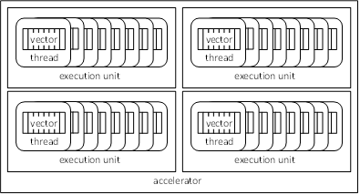
OpenACC Device Model
Currently OpenACC does not allow user-specified synchronization across threads.

Slide 11
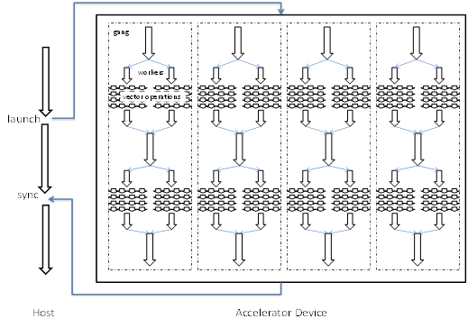
OpenACC Execution Model (Terminology: Gangs and Works)

Slide 12
Parallel vs. Loop Constructs
#pragma acc parallel loop copyin(M[0:Mh*Mw]) copyin(N[0:Nw*Mw]) copyout(P[0:Mh*Nw])
for (int i=0; i<Mh; i++) {
…
}
is equivalent to:
#pragma acc parallel copyin(M[0:Mh*Mw]) copyin(N[0:Nw*Mw]) copyout(P[0:Mh*Nw])
{
#pragma acc loop
for (int i=0; i<Mh; i++) {
…
}
}
(a parallel region that consists of just a loop)

Slide 13
Parallel Construct
A parallel construct is executed on an accelerator
One can specify the number of gangs and number of works in each gang
Programmer’s directive
#pragma acc parallel copyout(a) num_gangs(1024) num_workers(32)
{
a = 23;
}
1024*32 workers will be created. a=23 will be executed redundantly by all 1024 gang leads

Slide 14
What does each “Gang Loop” do?
#pragma acc parallel num_gangs(1024)
{
for (int i=0; i<2048; i++) {
…
}
}
#pragma acc parallel num_gangs(1024)
{
#pragma acc loop gang
for (int i=0; i<2048; i++) {
…
}
}
The for-loop will be redundantly executed by 1024 gangs
The 2048 iterations of the for-loop will be divided among 1024 gangs for execution

Slide 15
Worker Loop
#pragma acc parallel num_gangs(1024) num_workers(32)
{
#pragma acc loop gang
for (int i=0; i<2048; i++) {
#pragma acc loop worker
for (int j=0; j<512; j++) {
foo(i,j);
}
}
}
1024*32=32K workers will be created, each executing 1M/32K = 32 instance of foo()

Slide 16
A More Complex Example
#pragma acc parallel num_gangs(32)
{
Statement 1; Statement 2;
#pragma acc loop gang
for (int i=0; i<n; i++) {
Statement 3; Statement 4;
}
Statement 5; Statement 6;
#pragma acc loop gang
for (int i=0; i<m; i++) {
Statement 7; Statement 8;
}
Statement 9;
if (condition)
Statement 10;
}
Statements 1 and 2 are redundantly executed by 32 gangs
The n for-loop iterations are distributed to 32 gangs

Slide 17
Kernel Regions
#pragma acc kernels
{
#pragma acc loop num_gangs(1024)
for (int i=0; i<2048; i++) {
a[i] = b[i];
}
#pragma acc loop num_gangs(512)
for (int j=0; j<2048; j++) {
c[j] = a[j]*2;
}
for (int k=0; k<2048; k++) {
d[k] = c[k];
}
}
Kernel constructs are descriptive of programmer intentions (Suggestions)

Slide 18
C/C++ vs. FORTRAN
// C or C++
#pragma acc <directive> <clauses>
{ … }
! Fortran
!$acc <directive> <clauses>
…
!$acc end <directive>

Slide 19
Any MORE Questions? Read Chapter 15

